Slide 1
Business Forecasting: Employee Attrition Through Machine Learning
Presented by Anthony Lopez, Emilia Elangwe, Iram Anwar and Thomas Sullivan

Slide 2
About Our Dataset
We chose a popular dataset from Kaggle that is based on IBM’s HR Analytics for employee attrition and performance.
The dataset contains roughly 1,400 unique values.
It analyzes the profiles of IBM’s employees based on characteristics such as, age, education, attrition, job role, etc.
We chose this dataset to see what factors into employee satisfaction and what can determine if an employee will remain with the company or go elsewhere.
With that in mind, we have worked to create a model that can predict this outcome as accurately as possible.

Slide 3
Technologies & Tools Used
Programming Language: Python
Libraries: Pandas, NumPy, Scikit-Learn, Matplotlib, Seaborn
Machine Learning Techniques: Feature Scaling, One-Hot Encoding, Hyperparameter Tuning (GridSearchCV)
Visualization: Matplotlib, Seaborn,Tableau
Evaluation Metrics: Accuracy Score, Confusion Matrix, Classification Report
Notes:
Mention tableau?

Slide 4
Methodology
The project follows a structured pipeline:
Data Preprocessing
Handling missing values
Encoding categorical variables
Standardizing numerical features
Model Training & Evaluation
Training models on unscaled data
Implementing feature selection and standardization
Hyperparameter tuning using GridSearchCV
Performance Metrics
Accuracy Score
Confusion Matrix
Classification Report (Precision, Recall, F1-score)

Slide 5
Expected Outcomes
A trained machine learning model capable of accurately predicting employee attrition
Identification of key factors contributing to employee turnover
Data visualization that provide clear, actionable insights for HR departments
Recommendations for targeted retention strategies based on model findings

Slide 6

Employee Dashboard
https://public.tableau.com/app/profile/thomas.sullivan6332/viz/EmployeeAttrition_17394072832230/Dashboard1?publish=yes
Notes:
What’s the use of this slide?

Slide 7
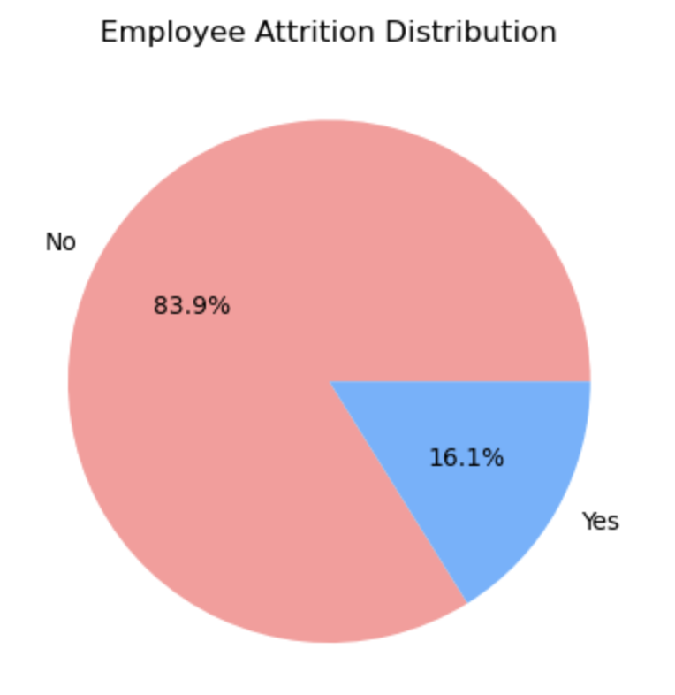
IBM’s Employee Attrition
Healthy companies are said to maintain roughly a 10% rate of attrition or less.
Here we have determined IBM to have people leaving the company at a 16.1% rate, from the data provided.
This attrition rate could help shine a light on a need for some sort of change in a company, whether that be management style or company culture.
Let’s take a look into the key factors that may lead us to this outcome.

Slide 8
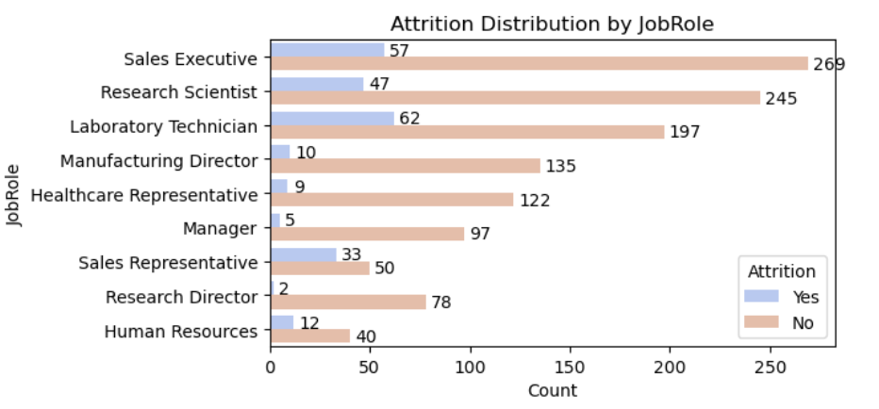
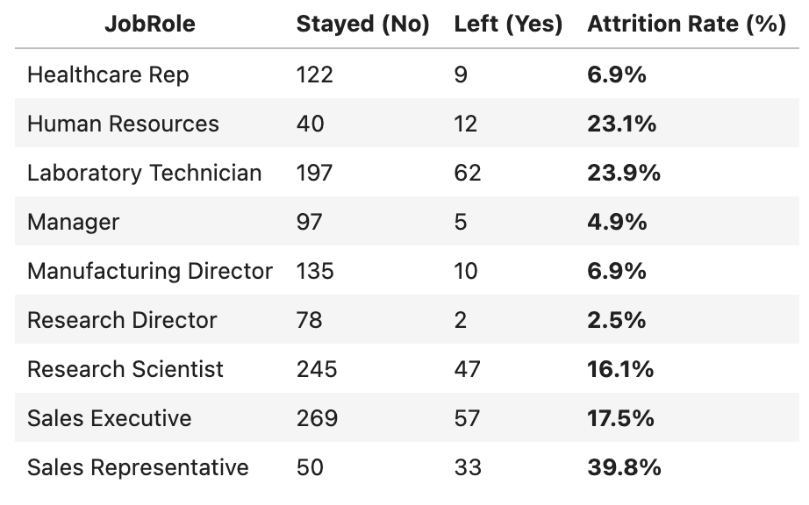
Attrition by Job Role
In this bar chart, we can see the number of employees who stayed in each role (tan) compared with the employees who left in each role (blue).
Taking a look at the data, we can infer that job role plays a role in the company’s attrition rate but how much?
Let’s take a look at the statistics.

Slide 9
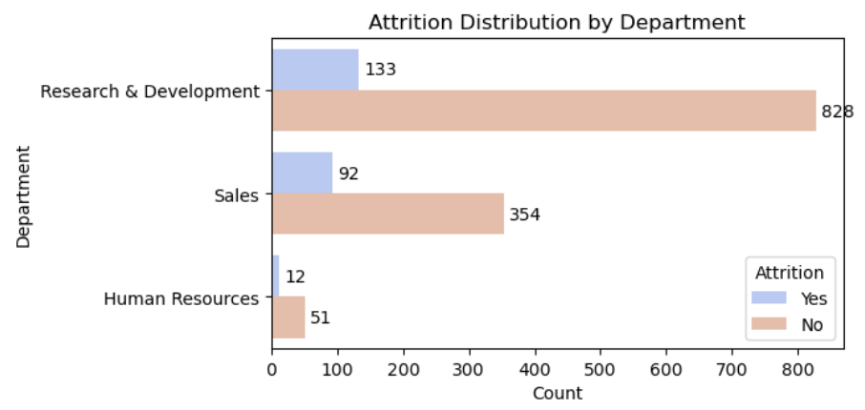
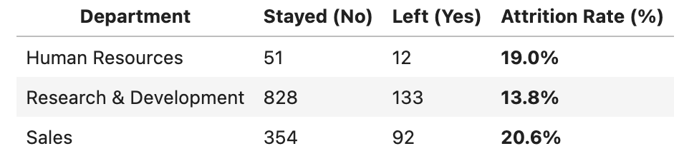
Attrition by Department
Sales has the highest attrition rate (20.6%), meaning employees in Sales roles are more likely to leave than in any other department.
Human Resources had only 12 people leave but still attained a high attrition rate of (19%).
Research & Development has the most optimal attrition rate (13.8%) out of the three departments.

Slide 10
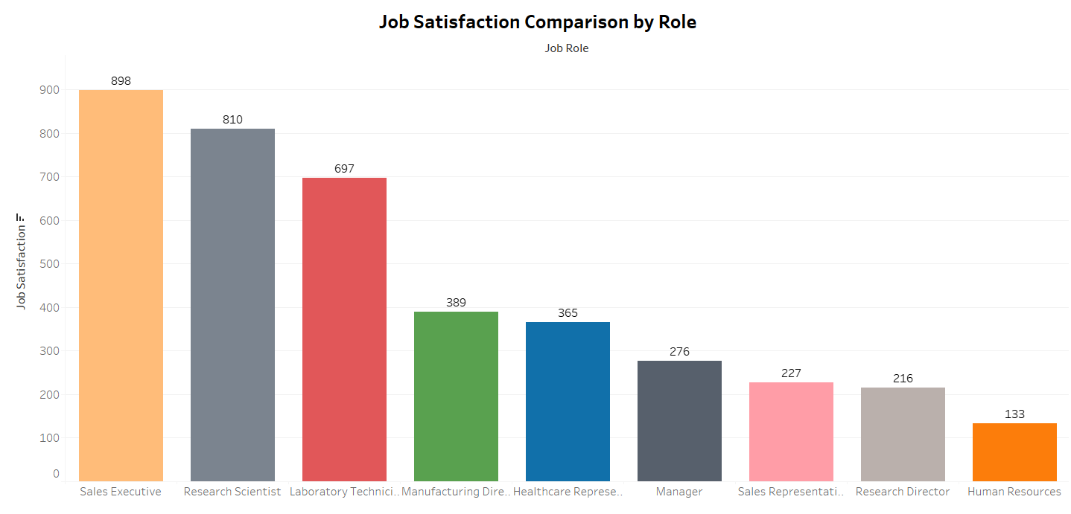
Job Satisfaction
In this graph, we can see that job satisfaction has a trend based on what job role an employee has.
The most satisfied employees are Sales Executives and Research Scientists.
The least satisfied employees are Human Resources and Research Directors.
How many of these employees stay with or leave the company?

Slide 11
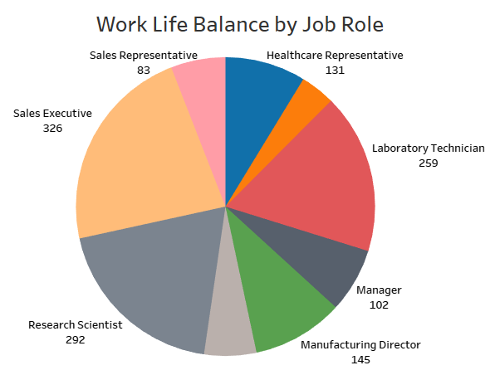
Work-Life Balance
This pie chart shows the breakdown of employees by their respective job roles.
The Sales Executive role has the highest representation with 326 employees, while Sales Representatives and Research Directors are the least represented, with only 83 and 80 employees, respectively.
This distribution can help identify areas where the organization may want to focus its recruitment efforts or adjust resource allocation.
Additionally, roles like Manager and Manufacturing Director could represent leadership opportunities for career development.

Slide 12
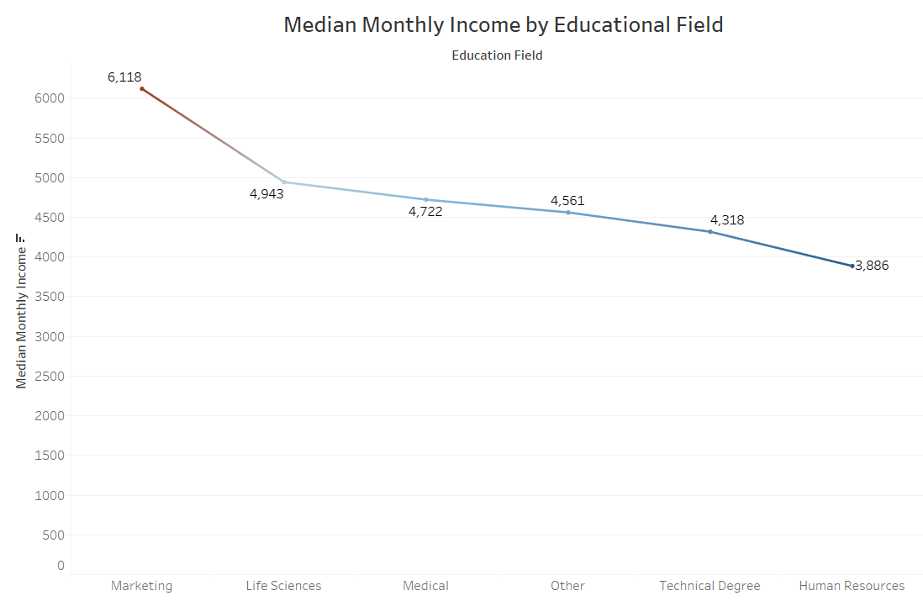
Monthly Income by Educational Field
This chart illustrates how median monthly income varies across different educational fields.
Marketing professionals earn the highest median income at $6,118, significantly surpassing other fields like Life Sciences and Medical Fields such as Technical Degrees and Human Resources, however, show lower median monthly incomes.
These trends could inform career decisions, suggesting higher earning potential in fields like Marketing, while also guiding employers in competitive salary benchmarking across different job categories.

Slide 13
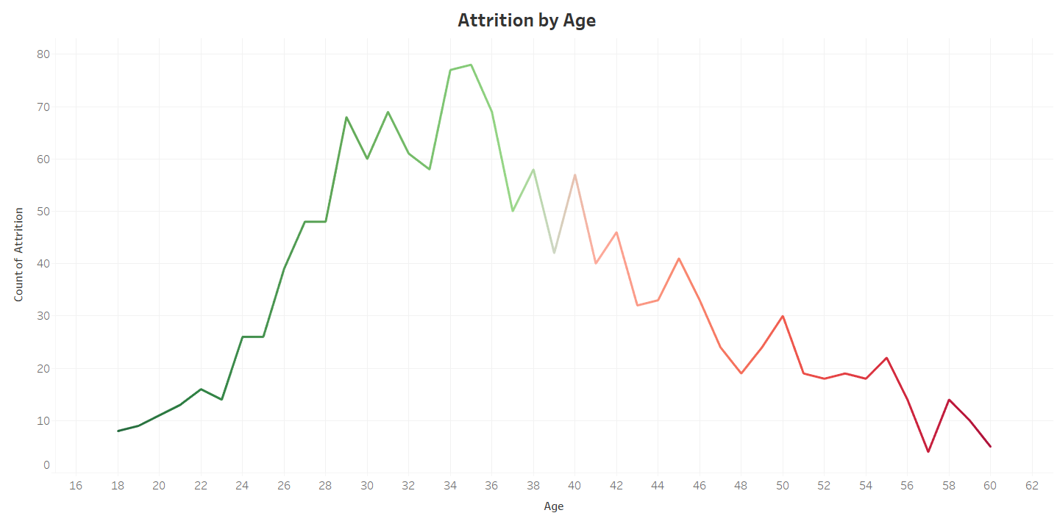
Age Group
This visualization shows the percentage of employees who left the company, broken down by age group.
By analyzing these patterns, we can better understand whether certain age demographics experience higher turnover rates, allowing for more focused retention efforts.
For example, if attrition is higher among younger employees, targeted initiatives like career development programs or mentorship opportunities could be implemented to reduce turnover in this group.

Slide 14
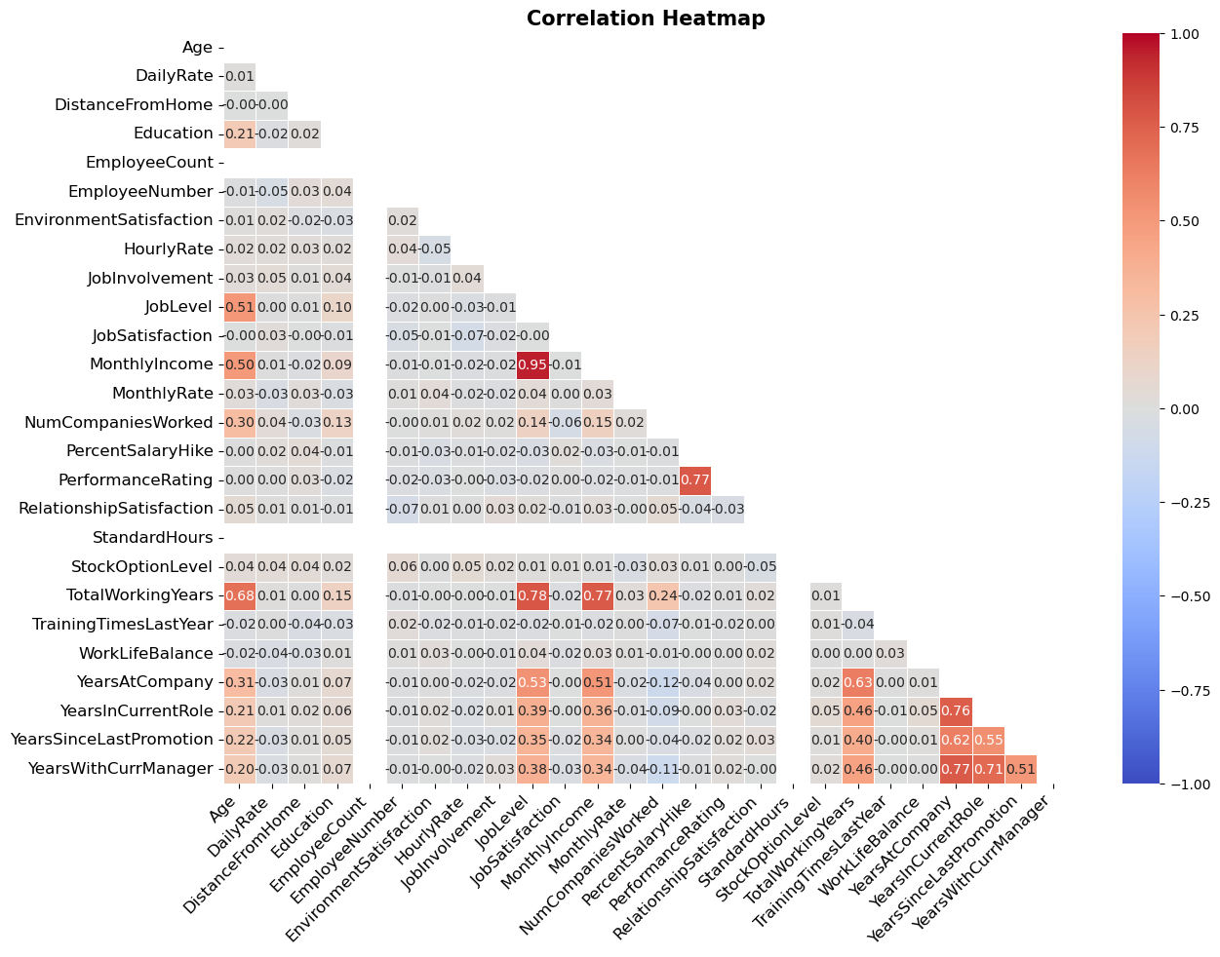
Heat Map

Slide 15
Machine Learning Models Used
We applied and evaluated the following models:
Logistic Regression
Decision Tree Classifier
Random Forest Classifier

Slide 16
Unscaled Data with No Feature Selection
Model | Cross-Validated Accuracy | Training Accuracy | Test Accuracy
Logistic Regression | 0.8408 | 0.8403 | 0.8424
Decision Tree | 0.7762 | 1.0000 | 0.7554
Random Forest | 0.8585 | 1.0000 | 0.8478

Slide 17
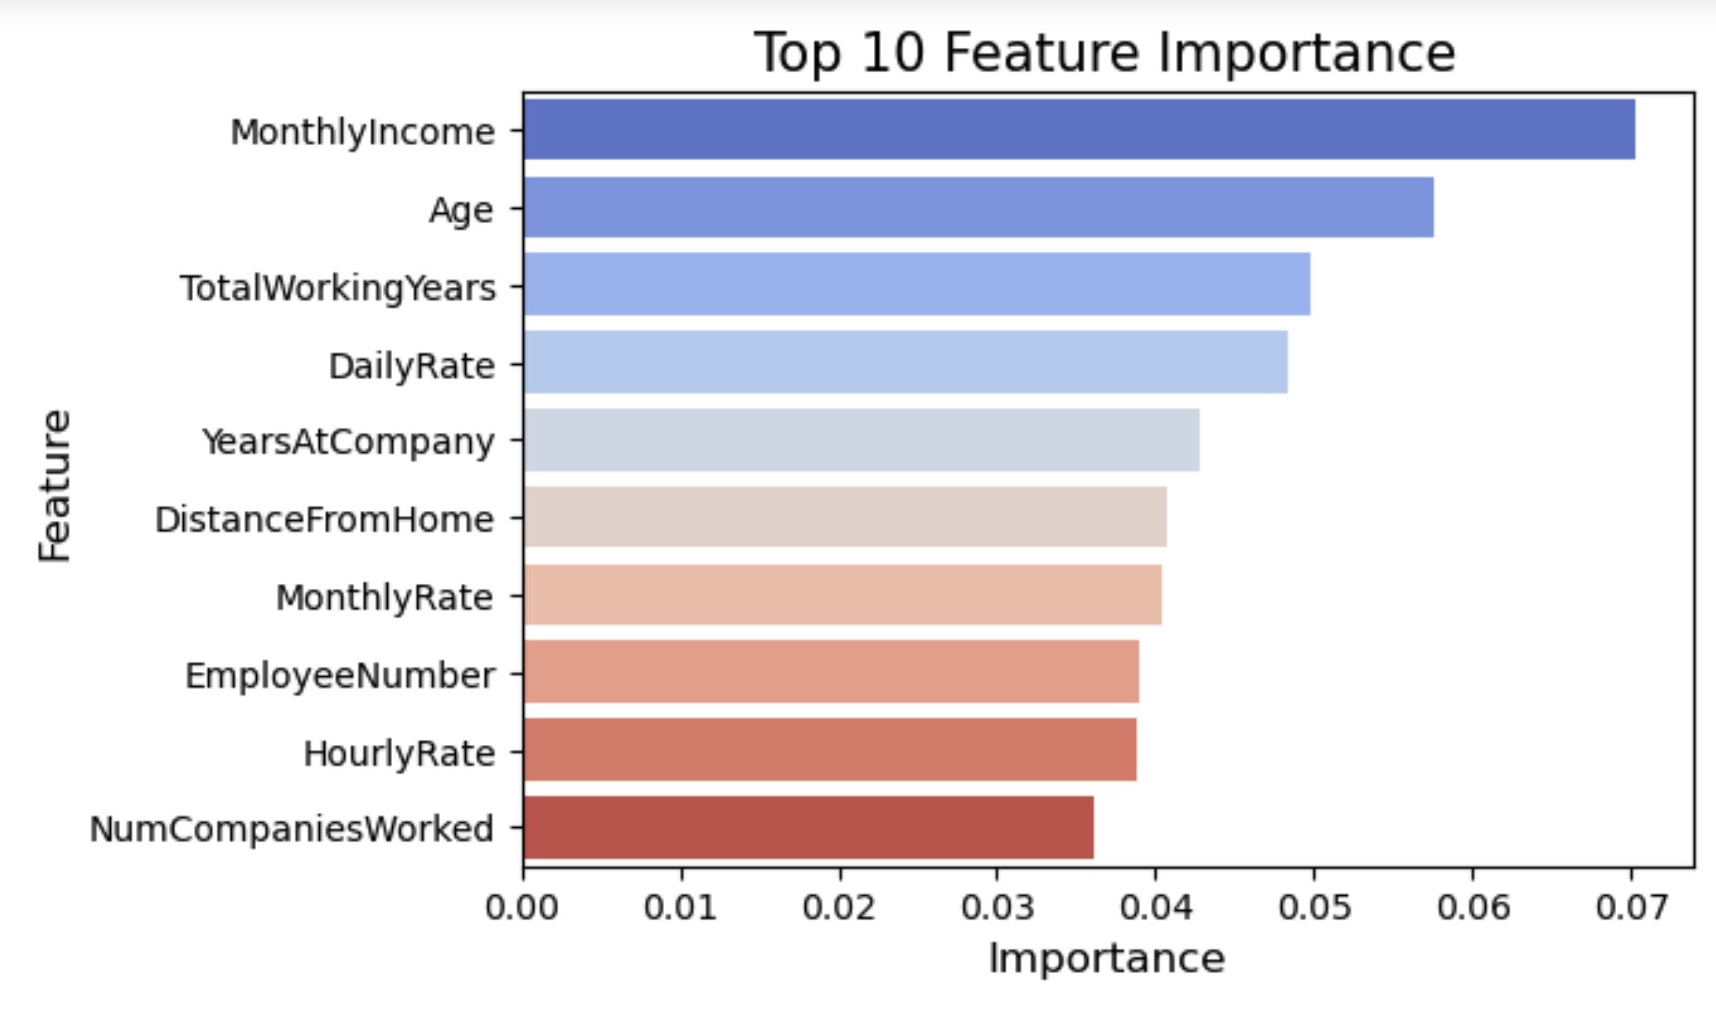
Notes:
How is this related to attrition rate?

Slide 18
Scaled Data with Feature Selection
Model | Cross Validated Accuracy | Training Accuracy | Test Accuracy
Logistic Regression | 0.8408 | 0.8838 | 0.3587
Decision Tree | 0.7776 | 1.0000 | 0.7609
Random Forest | 0.8612 | 1.0000 | 0.8397

Slide 19
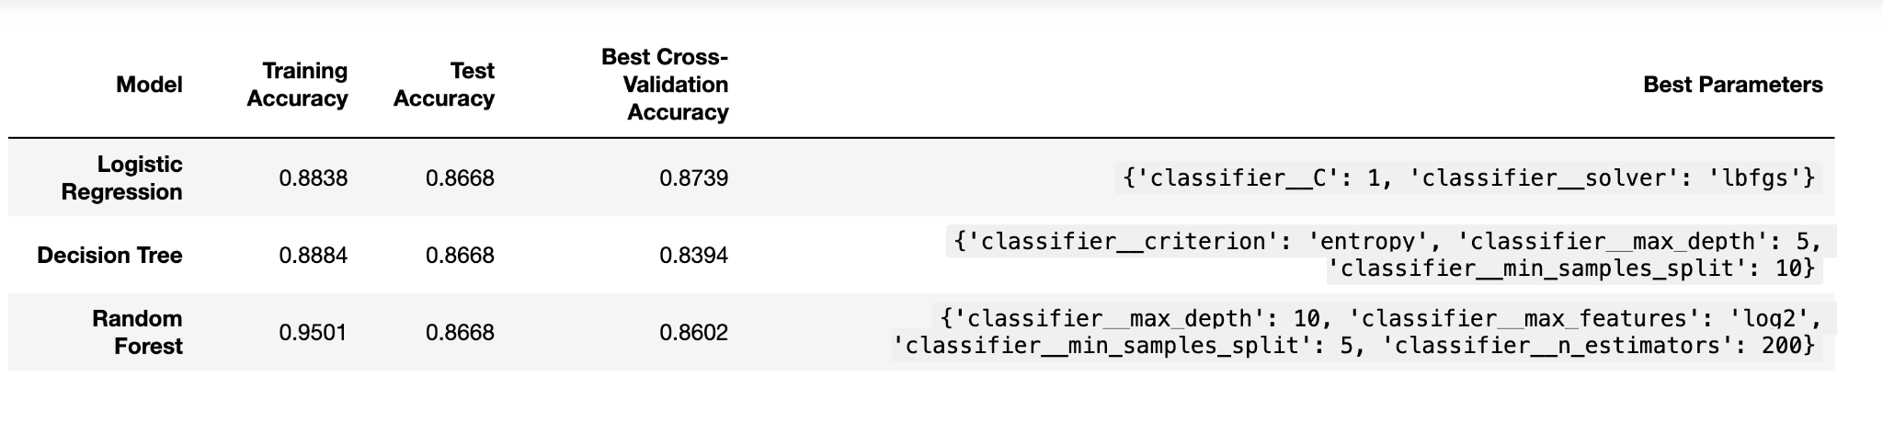
Best Hyperparameters and Results After GridSearch
Notes:
All three models (Logistic Regression, Decision Tree, and Random Forest) achieved similar test accuracies (86.68%).
Logistic Regression had the highest cross-validation accuracy, suggesting it might be more stable across different subsets of the training data.
Decision Tree showed a significant drop in cross-validation accuracy, indicating it might have overfitted to the training data during cross-validation but still generalized well on the test set.
Random Forest had a good cross-validation accuracy and performed similarly to the other models on the test set.

Slide 20
Model Performance Summary
Model | Cross Validated Accuracy | Training Accuracy | Test Accuracy
Logistic Regression (Unscaled) | 0.8408 | 0.8403 | 0.8424
Decision Tree (Unscaled) | 0.7762 | 1.0000 | 0.7554
Random Forest (Unscaled) | 0.8585 | 1.0000 | 0.8478
Logistic Regression (Scaled & Selected) | 0.8408 | 0.8838 | 0.3587
Decision Tree (Scaled & Selected) | 0.7776 | 1.0000 | 0.7609
Random Forest (Scaled & Selected) | 0.8612 | 1.0000 | 0.8397
Logistic Regression (Grid Search) | 0.8739 | 0.8838 | 0.8668
Decision Tree (Grid Search) | 0.8394 | 0.8884 | 0.8668
Random Forest (Grid Search) | 0.8602 | 0.9501 | 0.8668

Slide 21
Model Selection Based on Performance
Logistic Regression is the most stable model because:
The test accuracy (0.8668) is close to both the training (0.8838) and cross-validation accuracy (0.8739).
This suggests it generalizes well and can make accurate predictions on new, unseen data.
Random Forest has high training accuracy (0.9501), but since its test accuracy is also 0.8668, it might be overfitting slightly.
However, its strong performance across all metrics makes it a good candidate if further regularization is applied.

Slide 22
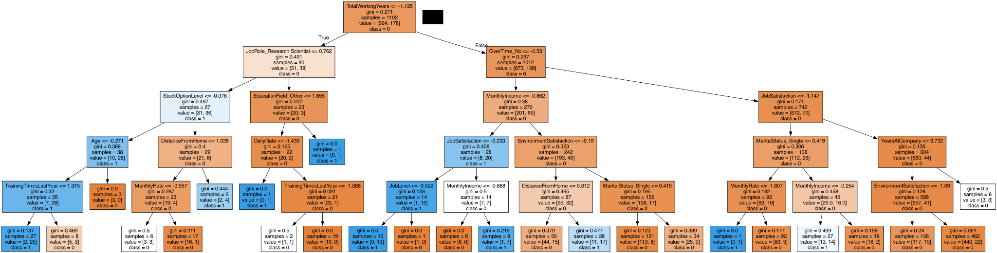
Decision Tree

Slide 23
Top Factors Driving Attrition:
Frequent Travel (24.9% attrition)
Sales Department (20.6%)
Sales Representative Job Role (39.8%—highest)
Human Resources and Laboratory Technicians (23% attrition)
Single Employees (25.5%)

Slide 24
Recommendations
1. Improve Employee Engagement:
Focus on increasing employee engagement, as disengaged employees are more likely to leave. Companies can improve engagement through regular feedback surveys, recognizing achievements, and involving employees in decision-making processes because our analysis shows that job satisfaction or work environment are highly correlated with attrition.
2. Address Work-Life Balance:
Introduce or enhance flexible working hours, remote working options, and wellness programs. Employees often leave because they feel overwhelmed with their workload or because they can't manage their personal lives alongside their professional responsibilities. The model shows that employees with poor work-life balance tend to leave, improving this aspect could be a key retention strategy.

Slide 25
Recommendations Continued
3. Address Uncompetitive Job Roles:
If employees in certain roles (e.g., specific departments) show higher attrition rates, evaluate whether these positions are competitive in terms of pay, responsibilities, and growth potential.
4. Implement Exit Interviews and Stay Interviews:
Exit interviews provide valuable insight into the reasons behind employee attrition, which can guide future retention strategies. Stay interviews allow you to proactively address concerns before they lead to resignations

Slide 26
Recommendations Continued
5. Strengthen Manager-Employee Relationships:
Offer management training programs to ensure that managers are effectively supporting their teams, providing feedback, and resolving conflicts.A poor relation with direct supervisors is a common reason for employee turnover.

Slide 27
Conclusion
These recommendations can be tailored based on the specific factors that are most correlated with attrition in the model. By addressing issues related to work environment, compensation, career development, and management practices, companies can reduce employee turnover and improve overall employee satisfaction. Implementing these strategies can result in a more loyal and motivated workforce, leading to higher productivity and retention rates.

Slide 28
References
https://www.kaggle.com/datasets/pavansubhasht/ibm-hr-analytics-attrition-dataset

